Slide 1
Multilayer Perceptrons (PART 2)

Slide 2
Chapter Organization
Back Propagation Learning
MLPs as Pattern Recognizers
Error Surface
Performance
Back Propagation Learning (revisited)
Supervised Learning as an optimization problem
Convolutional Networks

Slide 3
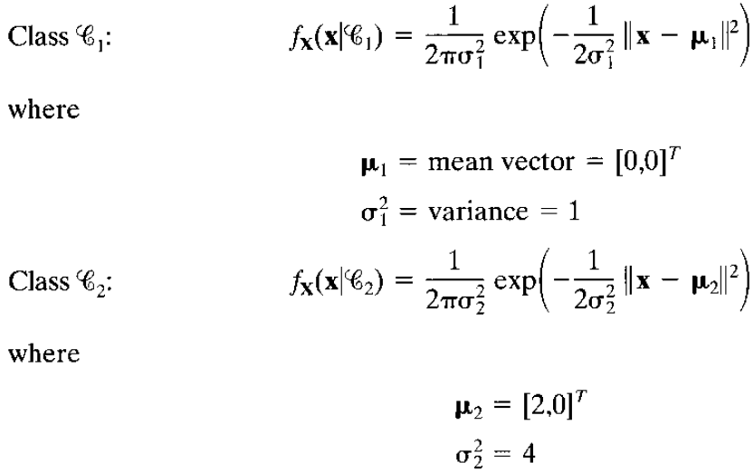
Computer Experiment
We will look at the learning behavior of an MLP used as a pattern classifier
Objective is to distinguish between 2 overlapping classes (Gaussian distributed patterns labeled 1 and 2)

Slide 4
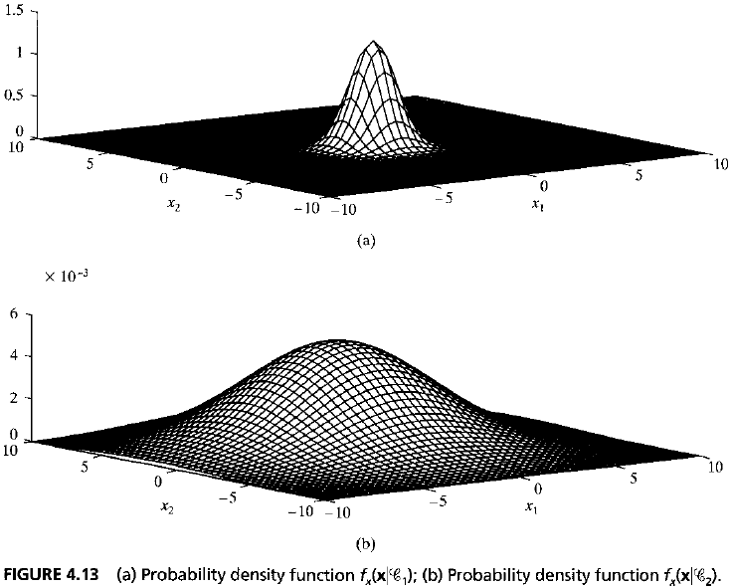
Computer Experiment

Slide 5
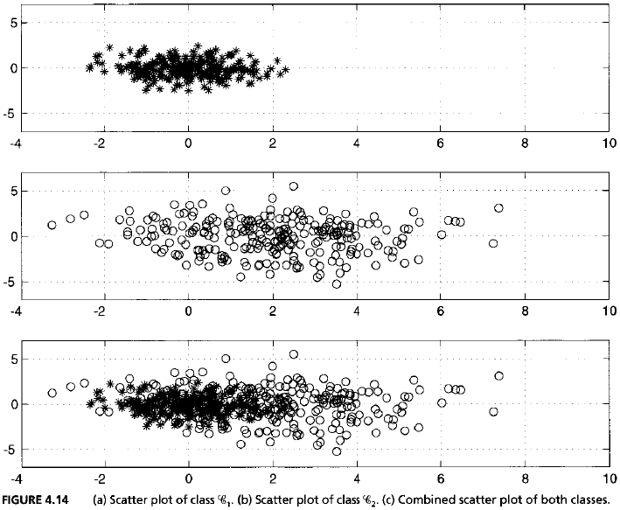
Computer Experiment

Slide 6
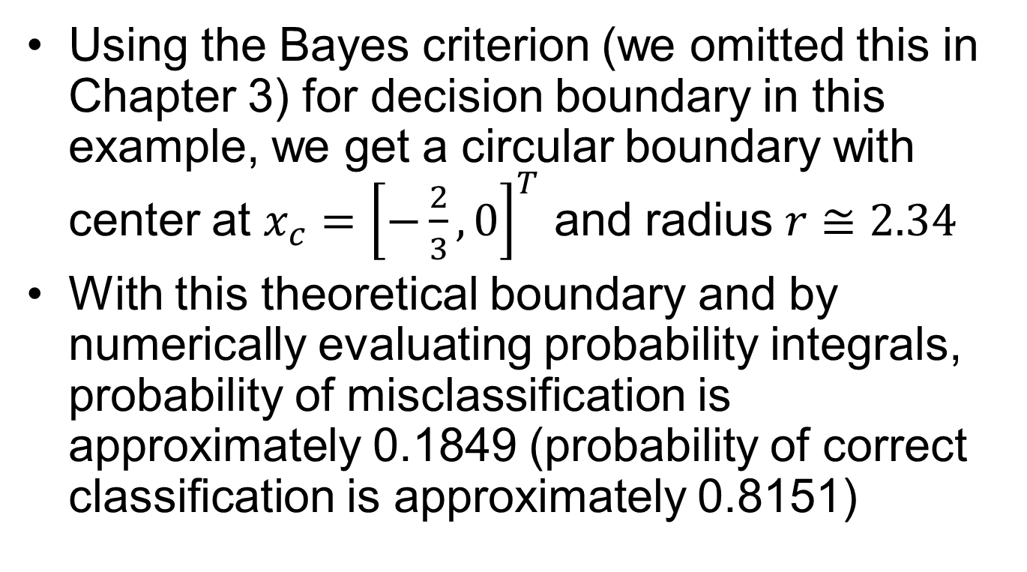
Computer Experiment Bayesian Decision Boundary
Using the Bayes criterion (we omitted this in Chapter 3) for decision boundary in this example, we get a circular boundary with center at $x_{c}={\left[−\frac{2}{3},0\right]}^{T}$ and radius $r≅2.34$
With this theoretical boundary and by numerically evaluating probability integrals, probability of misclassification is approximately 0.1849 (probability of correct classification is approximately 0.8151)

Slide 7
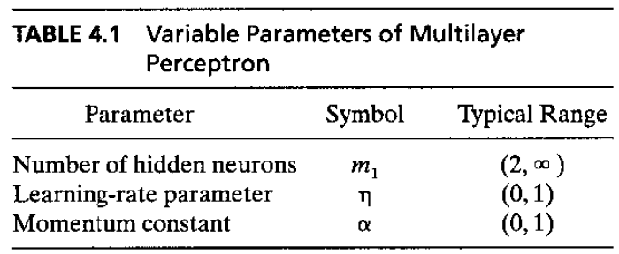
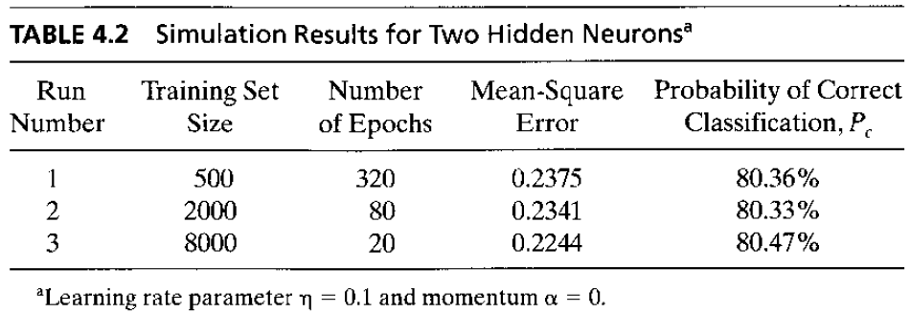
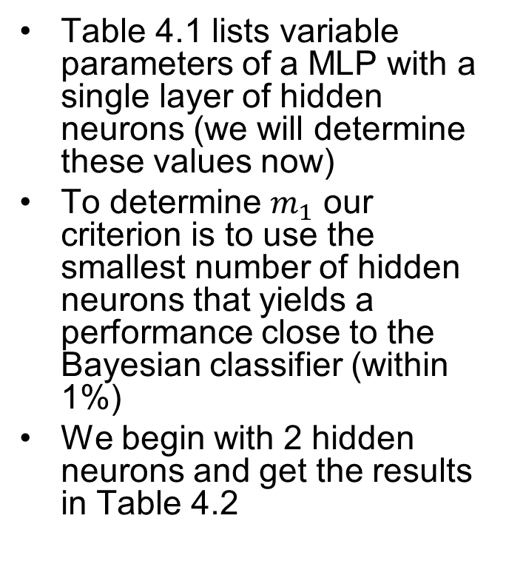
Computer Experiment Experimental Determination of Optimal MLP
Table 4.1 lists variable parameters of a MLP with a single layer of hidden neurons (we will determine these values now)
To determine $m_{1}$ our criterion is to use the smallest number of hidden neurons that yields a performance close to the Bayesian classifier (within 1%)
We begin with 2 hidden neurons and get the results in Table 4.2

Slide 8
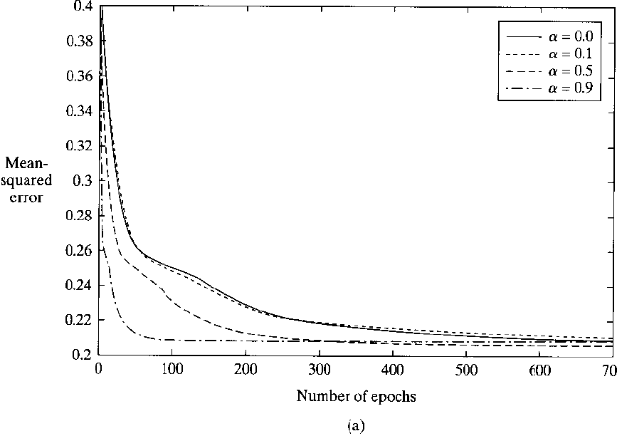
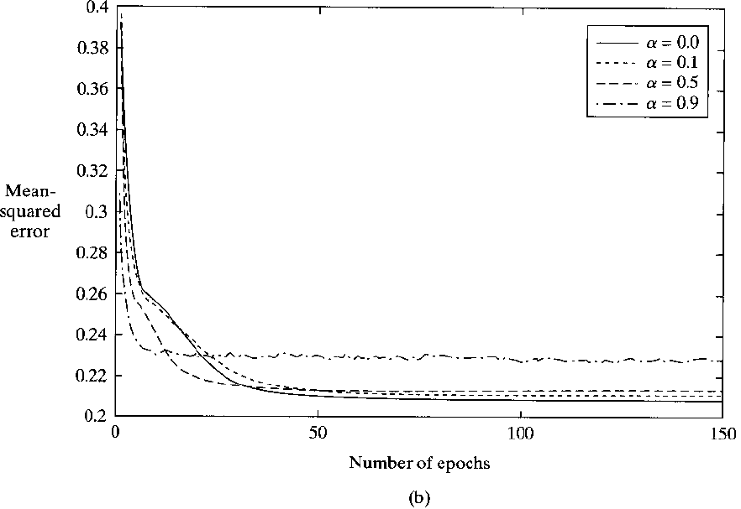



Computer Experiment Experimental Determination of Optimal MLP
$$η=0.01$$
Combinations of $η∈\left\{0.01, 0.1, 0.5, 0.9\right\}$ and momentum $α∈\left\{0.0, 0.1, 0.5, 0.9\right\}$ are simulated
$$η=0.1$$

Slide 9
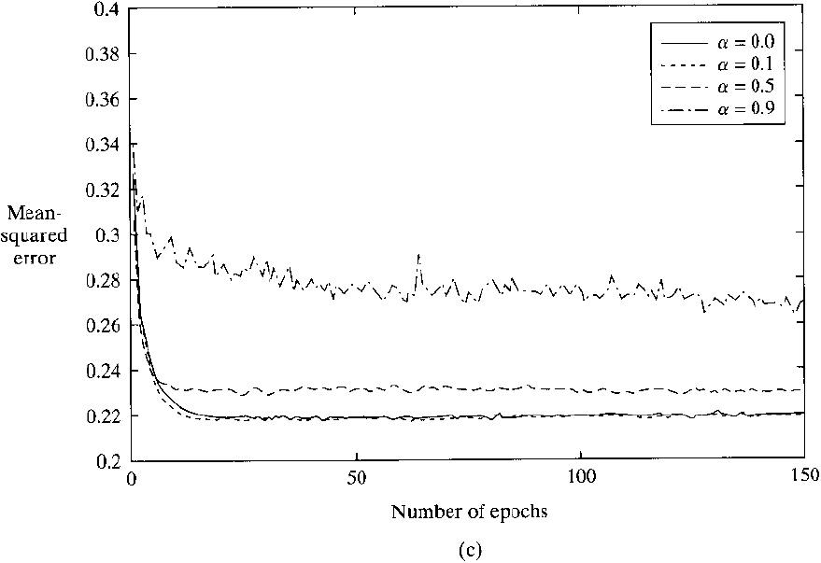
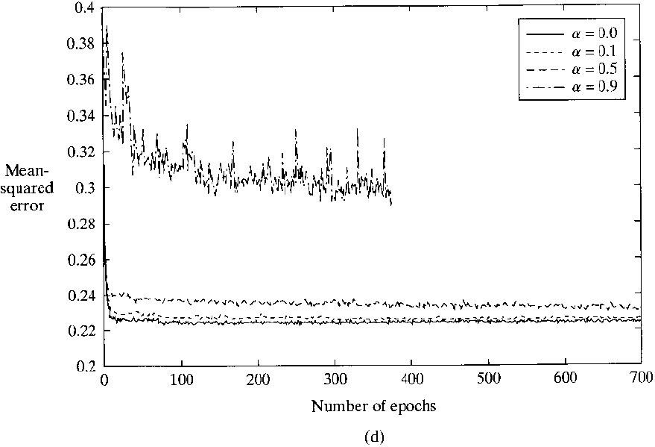
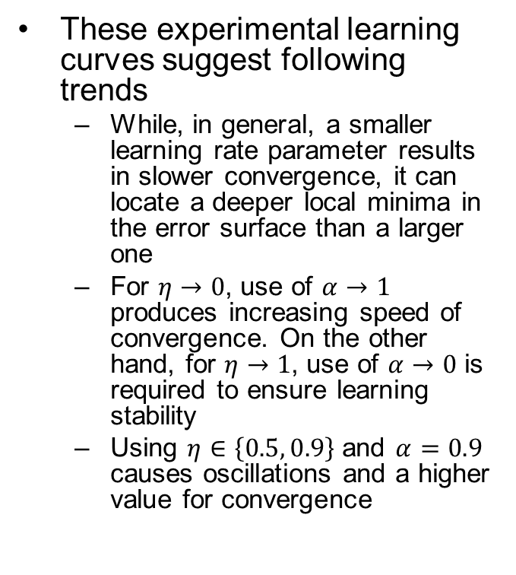


Computer Experiment Experimental Determination of Optimal MLP
$$η=0.5$$
These experimental learning curves suggest following trends
While, in general, a smaller learning rate parameter results in slower convergence, it can locate a deeper local minima in the error surface than a larger one
For $η→0$, use of $α→1$ produces increasing speed of convergence. On the other hand, for $η→1$, use of $α→0$ is required to ensure learning stability
Using $η∈\left\{0.5, 0.9\right\}$ and $α=0.9$ causes oscillations and a higher value for convergence
$$η=0.9$$

Slide 10
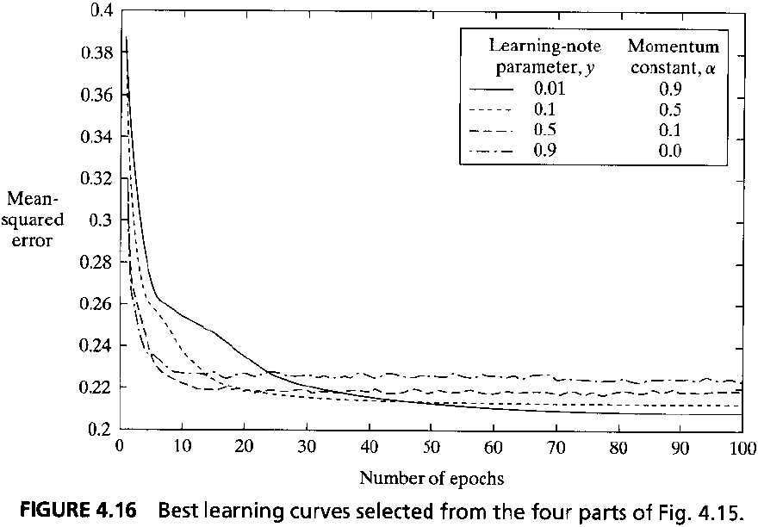
Computer Experiment Experimental Determination of Optimal MLP

Slide 11
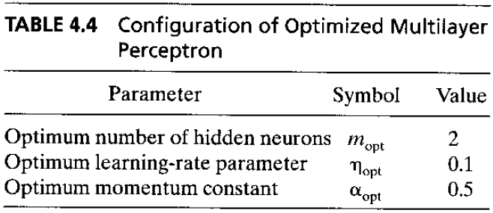
Computer Experiment Experimental Determination of Optimal MLP

Slide 12
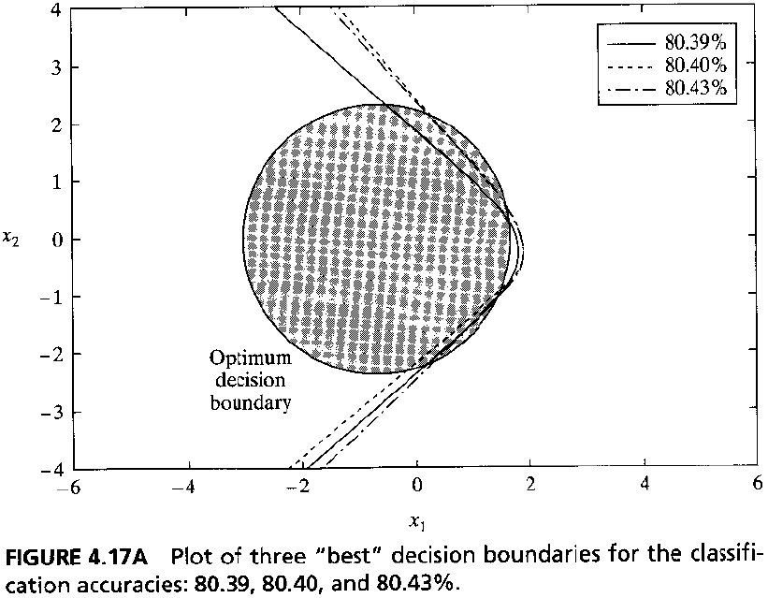
Computer Experiment Evaluation of MLP

Slide 13
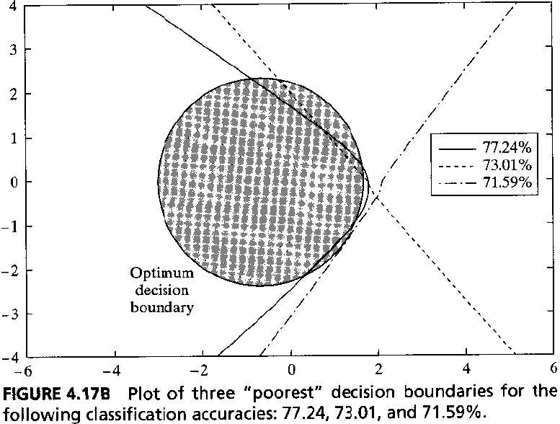
Computer Experiment Evaluation of MLP

Slide 14
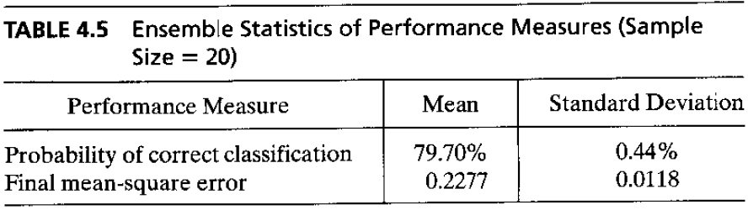
Computer Experiment Evaluation of MLP

Slide 15
Feature Detection
In the operation of a MLP with back-propagation learning, hidden neurons act as feature detectors.
As learning progresses, they discover salient features that characterize the training data.
They do so by performing a nonlinear transformation on the input data into feature space (hidden space)

Slide 16
Chapter Organization
Back Propagation Learning
MLPs as Pattern Recognizers
Error Surface (omitted)
Performance
Back Propagation Learning (revisited)
Supervised Learning as an optimization problem
Convolutional Networks

Slide 17
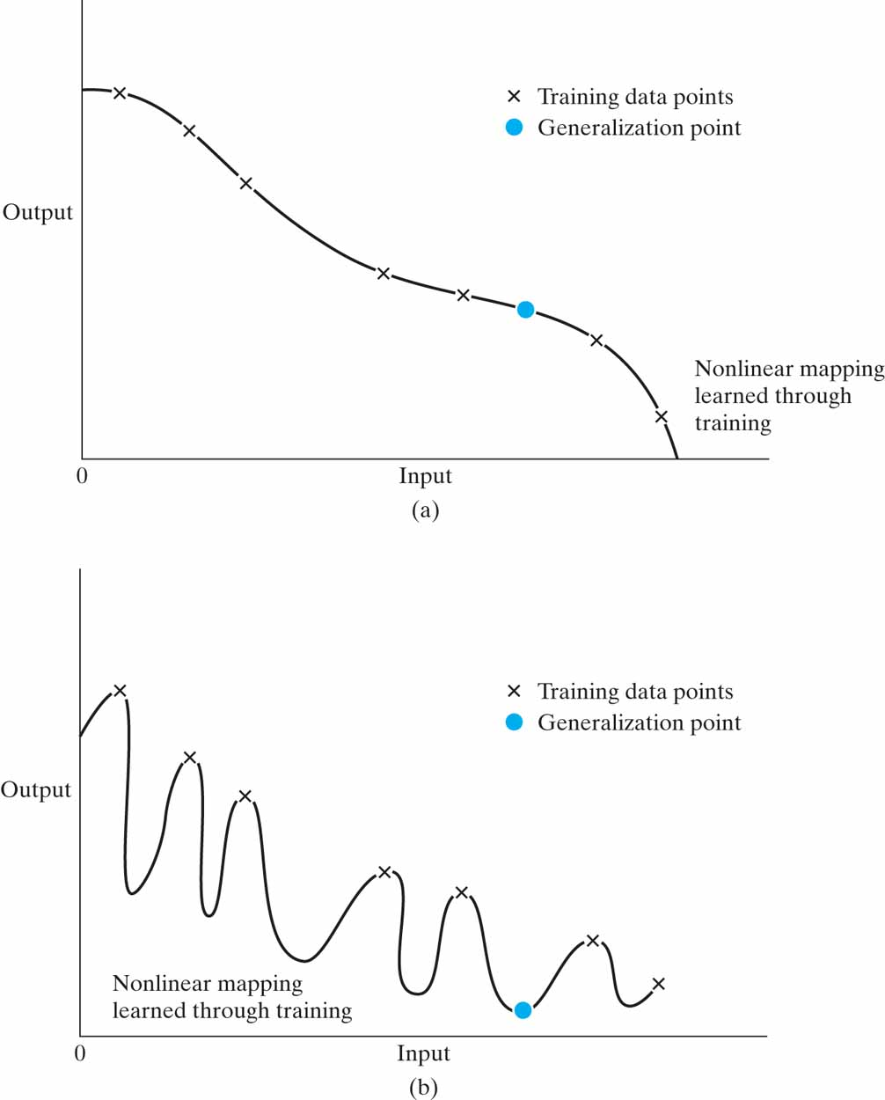
Generalizations
A network is said to generalize well when the input-output mapping computed by the network is correct (or nearly so) for test data never used in creating or training the network
An ANN may learn too many examples and end up memorizing the training data (overfitting, overtraining)

Slide 18
Generalizations
Generalization is influenced by three factors
Size of the training set and how representative it is of the environment of interest
Architecture of the ANN
Physical complexity of the problem at hand
We have no control over the last
For the other two, we can view generalization from 2 perspectives
The architecture is fixed and the issue is to determine the training set size
The training set size is fixed and the issue is to determine the best architecture

Slide 19
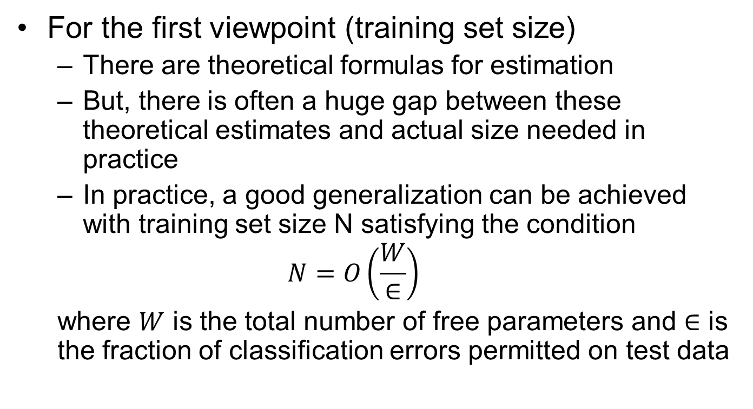
Generalizations
For the first viewpoint (training set size)
There are theoretical formulas for estimation
But, there is often a huge gap between these theoretical estimates and actual size needed in practice
In practice, a good generalization can be achieved with training set size N satisfying the condition
$$N=O\left(\frac{W}{∈}\right)$$
where $W$ is the total number of free parameters and $∈$ is the fraction of classification errors permitted on test data

Slide 20
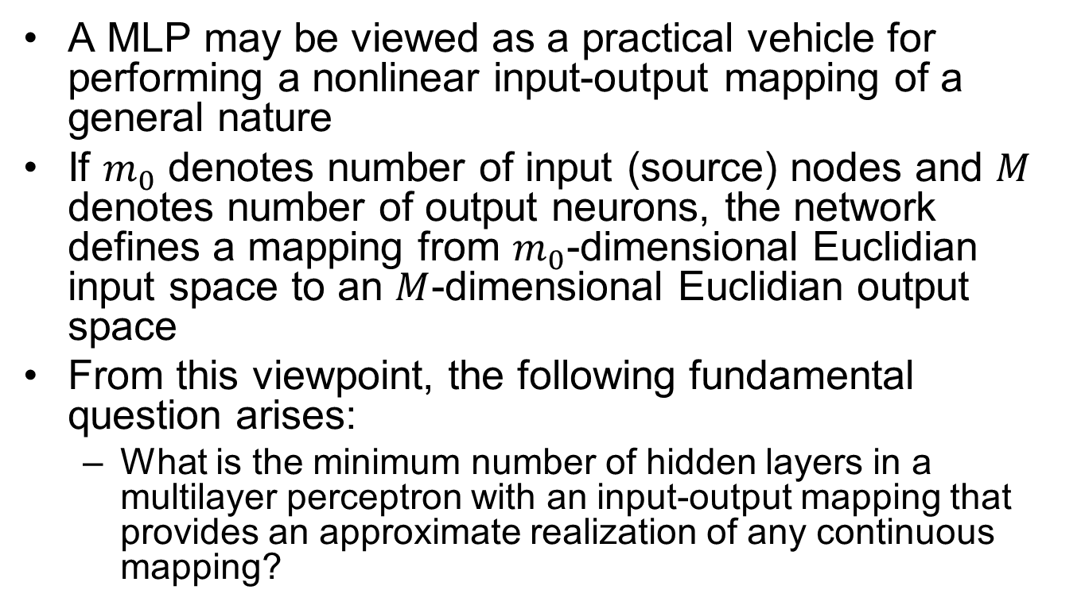
Approximations of Functions
A MLP may be viewed as a practical vehicle for performing a nonlinear input-output mapping of a general nature
If $m_{0}$ denotes number of input (source) nodes and $M$ denotes number of output neurons, the network defines a mapping from $m_{0}$-dimensional Euclidian input space to an $M$-dimensional Euclidian output space
From this viewpoint, the following fundamental question arises:
What is the minimum number of hidden layers in a multilayer perceptron with an input-output mapping that provides an approximate realization of any continuous mapping?

Slide 21
Approximations of Functions
The answer is embodied in the Universal Approximation Theorem (we skip the details)
In effect, it states that a single hidden layer is sufficient
However, it does not say that a single hidden layer is optimum in terms of learning time, ease of implementation, or generalization

Slide 22
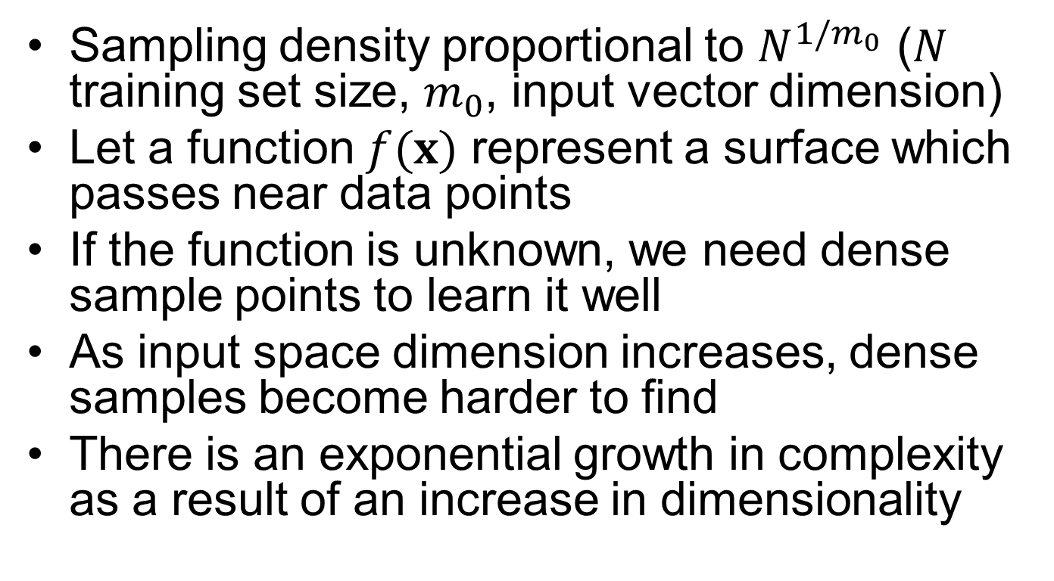
Curse of Dimensionality
Sampling density proportional to $N^{1/m_{0}}$ ($N$ training set size, $m_{0}$, input vector dimension)
Let a function $f(x)$ represent a surface which passes near data points
If the function is unknown, we need dense sample points to learn it well
As input space dimension increases, dense samples become harder to find
There is an exponential growth in complexity as a result of an increase in dimensionality

Slide 23
Practical Considerations
Universal Approximation Theorem gives us important results but it is not constructive (it does not show us how to determine a MLP with stated properties)
It assumes that the function to be approximated is given and that a hidden layer of unlimited size is available
Both assumptions are violated in most practical applications
The problem with MLPs with single hidden layers is that neurons interact with each other globally (difficult to improve the approximation at 1 point, without worsening it at other points)

Slide 24
Practical Considerations
With 2 hidden layers, approximation process becomes more manageable
Local features are extracted in the first hidden layer
Global features are extracted in the second layer

Slide 25
Cross-Validation
First, randomly partition the available data into a training set and a test set
Then, further divide the training set into 2 disjoint subsets
Estimation subset (used to select the model)
Validation subset (used to test or validate the model)
The motivation is to validate the model on a data set different from the one used for parameter estimation
In this way, we may use the training set to assess the performance of various candidate models (and thereby choose the best one)
There is a possibility, however, that best performing model may end up overfitting the validation subset
To prevent this, generalization performance is measured on the test set (different from the validation subset)
Using 80% of training set for estimation and remaining 20% for validation is accepted to be sensible

Slide 26
Early Stopping Method of Training
Ordinarily, a MLP learns in stages moving from realizing a fairly simple to more complex mapping as training progresses
Mean-square error decreases with increasing number of epochs until it reaches a local minimum on the error surface
When the goal is good generalization, it is difficult to figure out when it is best to stop training by just looking at the learning curve (it is possible to overfit the training data if we do not stop at the right point)
Overfitting can be identified by using cross-validation

Slide 27
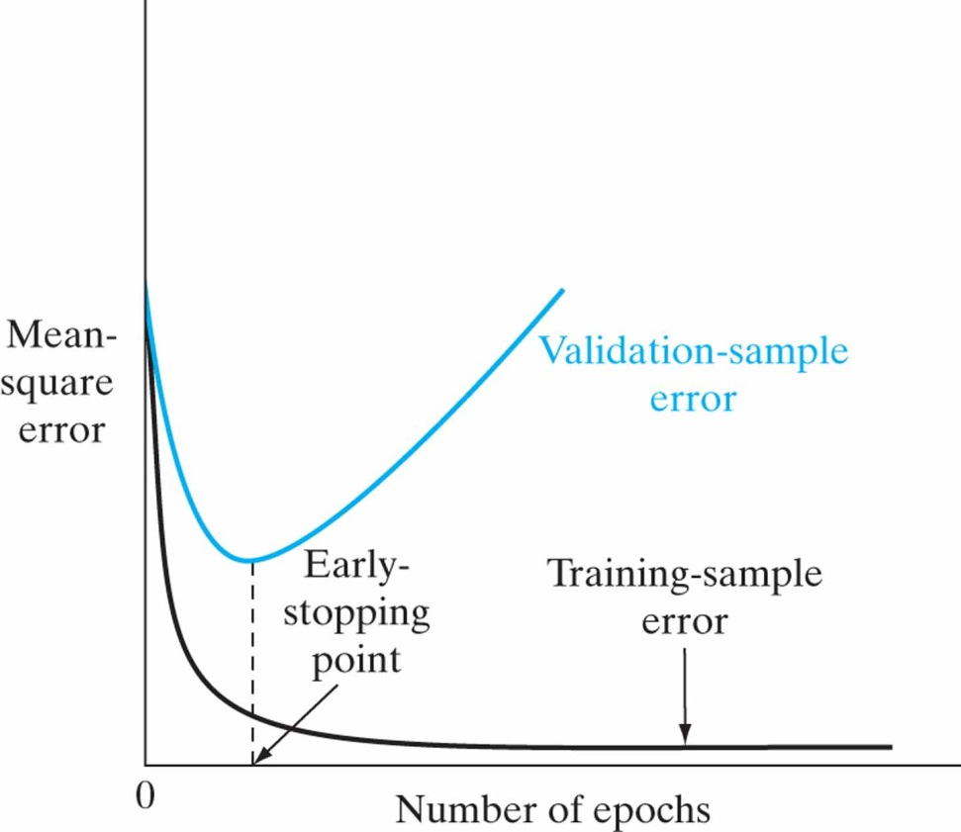
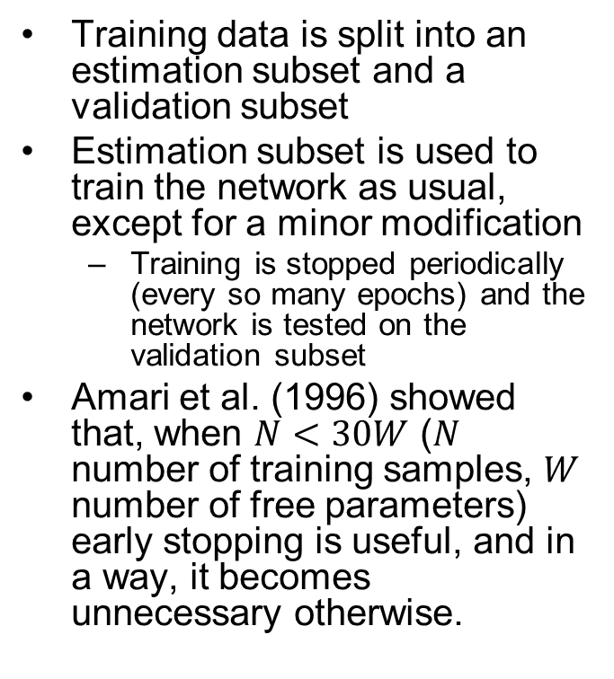
Early Stopping Method of Training
Training data is split into an estimation subset and a validation subset
Estimation subset is used to train the network as usual, except for a minor modification
Training is stopped periodically (every so many epochs) and the network is tested on the validation subset
Amari et al. (1996) showed that, when $N<30W$ ($N$ number of training samples, $W$ number of free parameters) early stopping is useful, and in a way, it becomes unnecessary otherwise.

Slide 28
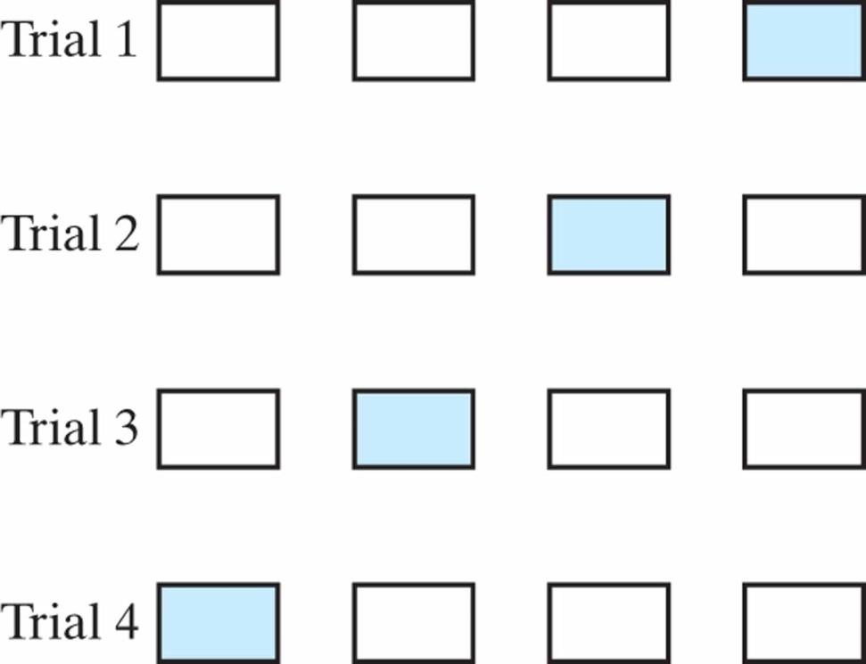
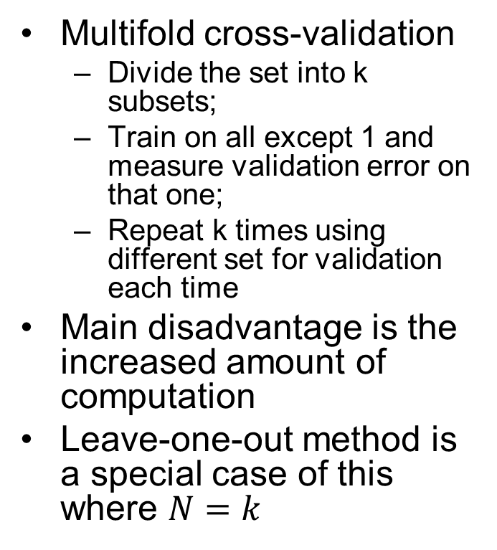
Variants of Cross-Validation
Multifold cross-validation
Divide the set into k subsets;
Train on all except 1 and measure validation error on that one;
Repeat k times using different set for validation each time
Main disadvantage is the increased amount of computation
Leave-one-out method is a special case of this where $N=k$

Slide 29
Network Pruning
In general, we want to minimize the network size while maintaining good performance. 2 ways to achieve this:
Network growing: start with a small MLP and increase neurons and/or layers when its performance is not satisfactory
Network pruning: start with a large MLP and prune it by weakening or eliminating certain synaptic weights in a selective and orderly fashion. 2 approaches:
One based on regularization
Another based on deletion

Slide 30
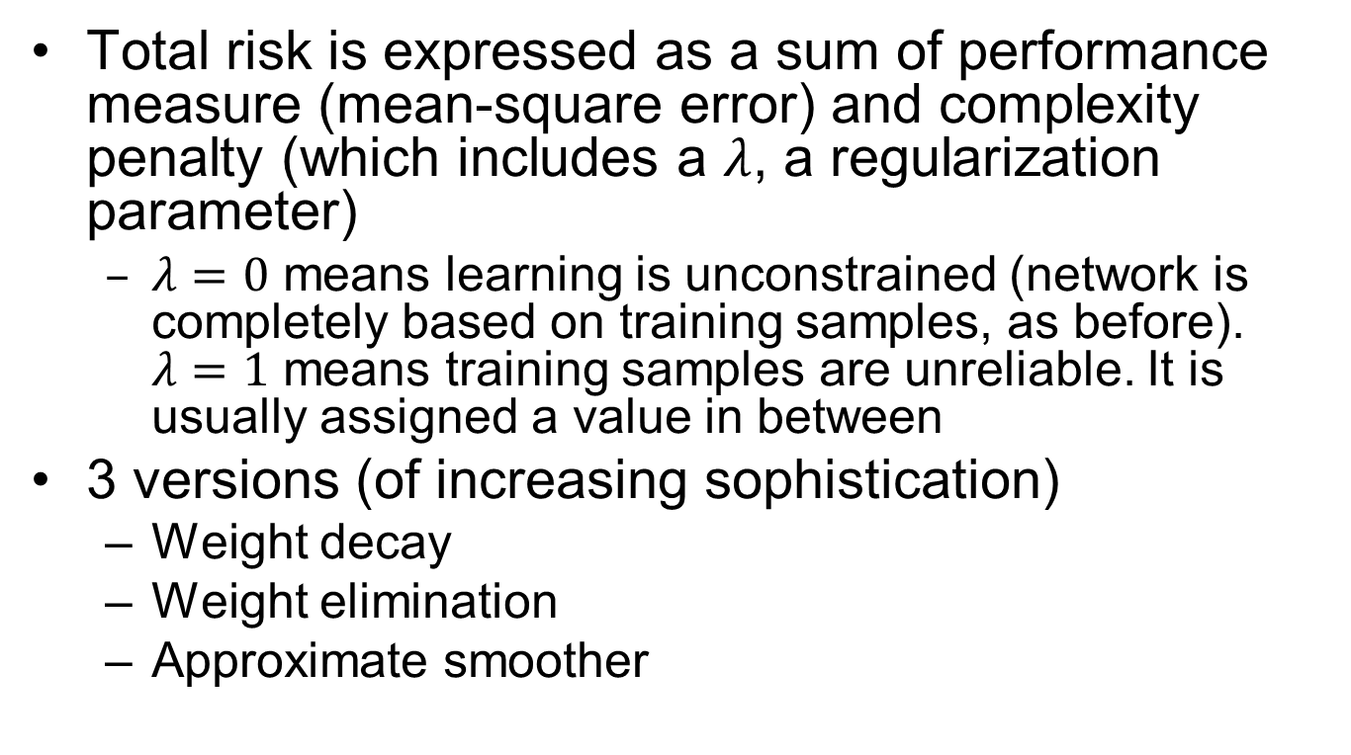
Complexity-Regularization
Total risk is expressed as a sum of performance measure (mean-square error) and complexity penalty (which includes a $λ$, a regularization parameter)
$λ=0$ means learning is unconstrained (network is completely based on training samples, as before). $λ=1$ means training samples are unreliable. It is usually assigned a value in between
3 versions (of increasing sophistication)
Weight decay
Weight elimination
Approximate smoother

Slide 31
Hessian-based Network Pruning
Use information on second-order derivatives of the error-surface to make a trade-off between network complexity and training error performance
Identify a set of parameters whose deletion from the network will cause the least increase in the value of the cost function. To solve this, following approximations are made:
External approximation: assume parameters are deleted after training has converged
Quadratic approximation: assume that error surface around a local/global minimum is nearly quadratic

Slide 32
Chapter Organization
Back Propagation Learning
MLPs as Pattern Recognizers
Error Surface (omitted)
Performance
Back Propagation Learning (revisited)
Supervised Learning as an optimization problem
Convolutional Networks

Slide 33
Virtues and Limitations of Back-Prop.
It has emerged as the most popular algorithm for the supervised training of MLPs
It is a gradient technique and not an optimization technique
It has 2 distinct properties:
It is simple to compute locally
It performs stochastic gradient descent in weight space
These 2 properties are responsible for its advantages and disadvantages

Slide 34
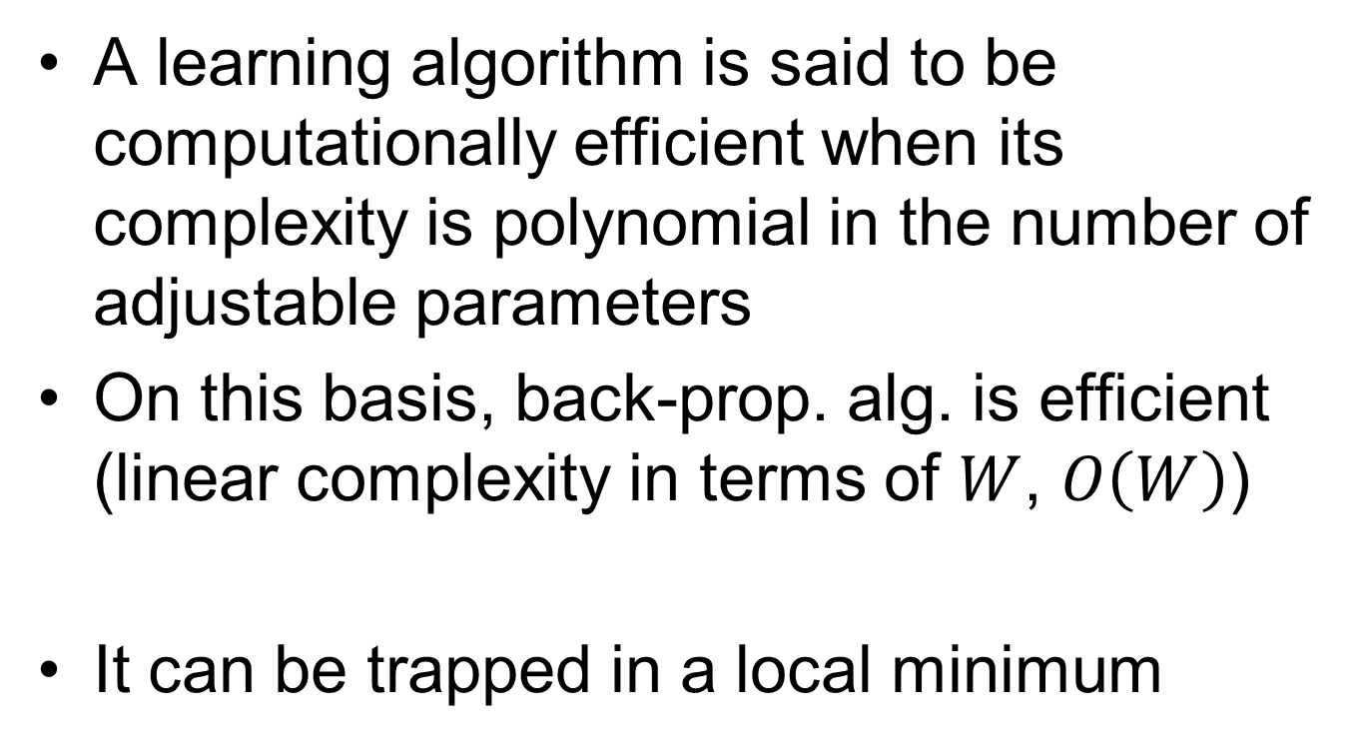
Virtues and Limitations of Back-Prop.
A learning algorithm is said to be computationally efficient when its complexity is polynomial in the number of adjustable parameters
On this basis, back-prop. alg. is efficient (linear complexity in terms of $W$, $O\left(W\right)$)
It can be trapped in a local minimum

Slide 35
Accelerated Convergence of Back Propagation Learning
Every adjustable parameter should have its own learning-rate parameter
Every learning-rate parameter should be allowed to vary between iterations
When cost function derivative w.r.t. a synaptic weight has the same sign for several iterations, the learning rate parameter should be increased
When cost function derivative w.r.t. a synaptic weight has alternating signs for several iterations, the learning rate parameter should be decreased

Slide 36
Chapter Organization
Back Propagation Learning
MLPs as Pattern Recognizers
Error Surface (omitted)
Performance
Back Propagation Learning (revisited)
Supervised Learning as an optimization problem (omitted)
Convolutional Networks

Slide 37
Convolutional Networks
A special class of MLPs designed specifically to recognize 2D shapes with a high degree of invariance to translation, scaling, skewing, and other forms of distortion
Network structure includes following constraints:
Feature extraction: Neurons take their inputs from a local receptive field (it is forced to extract local features). Once a feature is extracted, its location becomes less important
Feature mapping: Each layer is composed of multiple feature maps (a plane within which neurons are constrained to share same weights). The effects are shift invariance and reduction in number of free parameters
Subsampling: Each convolutional layer is followed by a computational layer performing local averaging and subsampling (feature map resolution is reduced). Feature map sensitivity to shifts and other distortions is reduced

Slide 38
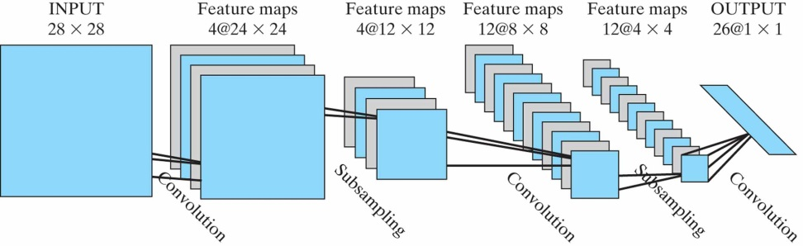
Convolutional Networks
A convolutional network made up of
An input layer
4 hidden layers
And an output layer
Designed to perform image processing (recognition of handwritten characters)
Alternating layers of convolution and subsampling
Contains about 100,000 synaptic connections but only 2600 free parameters

